Slide 1
8085 Instruction Types & Execution

Slide 2
8085 - Instruction Word Size
1 Byte ------------- MOV C,A 0100 1111 4F
ADD B 1000 0000 80
CMA 0010 1111 2F
(occupies 1 memory location)
_________________________________________________________________________________________
2 Byte -------------- MVI A,32H 0011 1110 3E
0011 0010 32
(occupies 2 memory location, operation code & operand in 8 bit)
__________________________________________________________________________________________
3 Byte ------------- LDA 2050H 0011 1010 3A
0101 0000 50
0010 0000 20
(occupies 3 memory locations, opcode & operand in 16 bit)

Slide 3
1 byte instruction – A mnemonic followed by a letter or two letters
MOV A,B
RRC
2 byte instruction – A mnemonic followed by 8 bit operand
MVI A, 00H
3 byte instruction - A mnemonic followed by 16 bit operand
LXI B, 16bit
CALL 16bitaddress

Slide 4
Opcode Format
Code | Registers
000 | B
001 | C
010 | D
011 | E
100 | H
101 | L
111 | A
110 | Memory related operations
00 | BC
01 | DE
10 | HL
11 | SP
1.Rotate each bit of the accumulator to the left by 1
00000 111 07H (8bit opcode)
2.Add the contents of a register to Accumulator
ADD B
10000 000 80H
3. Move the contents from Rs to Rd
MOV C,A
01 001 111 4F

Slide 5
Opcodes for instructions
MOV A,32H 3E
32
MVI B,48H 06
48
ADD B 80
OUT 01H D3
01
HLT 76

Slide 6
Program stored in Memory
Mnemonics Hexcode Binarycode Mem_addr
MOV A,32H 3E 00111110 2000
32 00110010 2001
MVI B,48H 06 00000110 2002
48 01001000 2003
ADD B 80 10000000 2004
OUT 01H D3 11010011 2005
01 00000001 2006
HLT 76 01111110 2007

Slide 7
Addressing Modes - 8085
Direct Addressing: In this mode, the operand is specified within the instruction itself . (Eg) LDA 4000H; STA 5513H
Register Addressing: In this mode of addressing, the operand are in the general purpose registers. (eg) MOV A, B ; ADD D
Register Indirect Addressing: MOV A, M; ADD M . These instructions utilise 1-byte. In this mode, instead of specifying a register, a register pair is specified to accommodate the 16-bit address of the operand
Immediate Addressing: MVI A, 07; ADI 0F are examples of Immediate Addressing mode. The operand is specified in the instruction in this mode.
Implicit Addressing: In this mode of addressing, the operand is fully absent. Examples are RAR, RAL, CMA, etc.

Slide 8
Timing & Control
The Timing & Contrl section is a part of CPU and generates timing and control signals for execution of instructions.
This section includes Clock signals, Control signals, Status signals, DMA signals as also the Reset section.
It controls fetching and decoding operations.
It also generates appropriate control signals for instruction execution as also the signals required to interface external devices.

Slide 9
Timing Diagram
A time diagram is a graphical representation.
The 8085 instruction timing diagram represents the execution time of each instruction in graphical format.
Execution time is given in T-states.
The 8085 microprocessor has a set of control signals and data signals that play an important role in the execution of instructions.

Slide 10
Signals
Clock Signal: The time required to execute an instruction is called a clock cycle.
Machine Cycle: The time required to access memory or input/output devices is called a machine cycle. The 8085 has 5 basic machine cycles i.e., load opcode, read from memory, write to memory, read I/O, and write I/O.
T-State: A machine cycle and an instruction cycle take several clock periods. The portion of an operation performed in one system clock period is called a T-state.
Control Signals: The control signal controls the operations. Common signals are ALE (address block enable), RD (read), WR (write), and IO/M (input/output) memory.

Slide 11
Control Signals
IO/ M signal indicates whether I/O or memory operation is being carried out. A high on this signal indicates I/O operation while a low indicates memory operation.
S0 and S1 indicate the type of machine cycle in progress

Slide 12
ALE
ALE pin which stands for ‘Address Latch Enable’.
ALE signal is used to demultiplex the lower order address bus (AD0 – AD7).
Pins 12 to 19 of 8085 are AD0 – AD7 which is the multiplexed address-data bus. Multiplexing is done to reduce the number of pins of 8085
ALE signal goes high at the beginning of T1 of each machine cycle and goes low at the end of T1 and remains low during the rest of the machine cycle.
This high to low transition of ALE signal at the end of T1 is used to latch the lower order address byte (A0 – A7) by the latch IC 74LS373, so that the lower byte A0 – A7 is continued to be available till the end of the machine cycle.

Slide 13
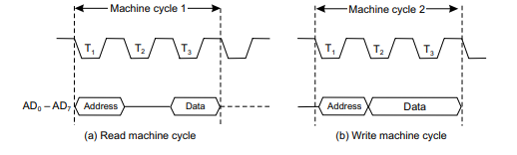
Read/Write
Data transfer from memory or I/O device to microprocessor or the reverse takes place during T2 and T3 states of the machine cycles.
In the read machine cycle, data appears at the beginning of T3 state, whereas in the write machine cycle, it appears at the beginning of T2

Slide 14
8085 Machine Cycles
The 8085 microprocessor has 5 basic machine cycles.
Opcode Fetch {4T- state}
Memory Read {3T- state}
Memory Write {3T- state}
I/O Read {3T- state}
I/O Write {3T- state}

Slide 15
Opcode Fetch Machine Cycle of 8085
Each processor instruction has a one byte opcode.
Operation codes are stored in memory. Thus, the processor performs an opcode load machine cycle to load the opcode from memory.
Thus, each instruction begins with a machine cycle of opcodes.
The time the processor takes to perform an opcode load cycle is 4T.
At this time, the first, 3T-states are used to load the opcode from memory, and the remaining T-states are used for internal opcodes.

Slide 16
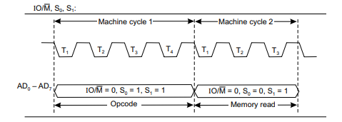
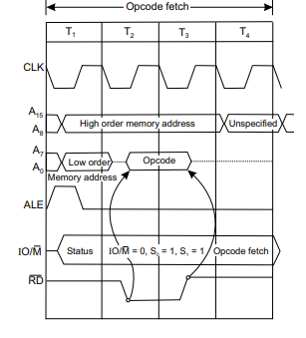

Slide 17
The first machine cycle of every instruction is the Opcode Fetch.
The length of this machine cycle varies between 4T to 6T states—it depends on the type of instruction.
The processor places the contents of the PC on the address lines, identifies the nature of machine cycle æ (by IO/M, S0, S1) and activates the ALE signal. All these occur in T1 state.
In T2 state, RD signal is activated so that the identified memory location is read from and places the content on the data bus (D0 – D7).
In T3, data on the data bus is put into the instruction register (IR) and also raises ææ the RD signal thereby disabling the memory.
In T4, the processor takes the decision, on the basis of decoding the IR, whether to enter into T5 and T6 or to enter T1 of the next machine cycle

Slide 18
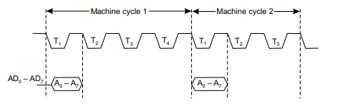
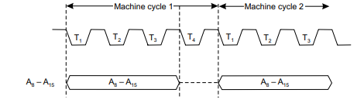
The lower byte of address (AD0 – AD7) is available on the multiplexed address/data bus during T1 state of each machine cycle, except during the bus idle machine cycle.
The higher byte of address (A8 – A15) is available during T1 to T3 states of each machine cycle, except during the bus idle machine cycle

Slide 19
Memory R/W
Both the Memory Read and Memory Write machine cycles are 3T states in length.
In Memory Read the contents of R/W memory (including stack also) or ROM are read while in Memory Write, it stores data into data memory (including stack memory).
During T2 and T3 states data from either memory or CPU are made available in Memory Read or Memory Write machine cycles respectively.
The status signal (IO/ M, S0, S1) states are complementary in nature in Memory Read and Memory Write cycles.
Reading or writing operations are performed in T2.
In T3 of Memory Read, data from data bus are placed into the specified register and raises RD so that memory is disabled while in T3 of Memory Write WR signal is raised which disables the memory.

Slide 20
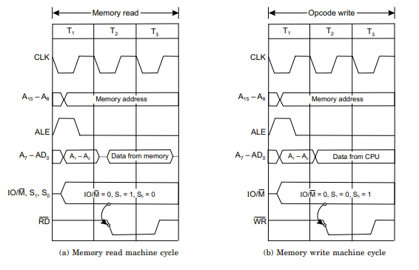

Slide 21
I/O R & W
I/O Read and Write machine cycles are almost similar to Memory Read and Write machine cycles respectively.
The difference is in the IO/ M signal status which remains 1 indicating that these machine cycles are related to I/O operations.
These machine cycles take 3T states.
In I/O read, data are available in T2 and T3 states, while during the same time (T2 and T3) data from CPU are made available in I/O write.

Slide 22
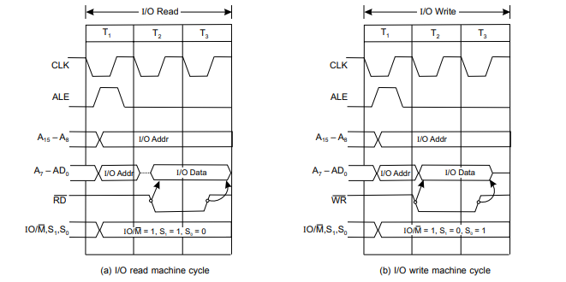

Slide 23
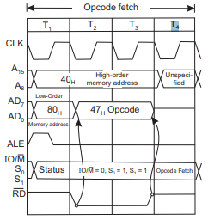
Timing Diagram of MOV A,B
Since the program counter sequences the execution of instructions, it is assumed that the PC holds the address 4080H AND accumumlator having the content FFH.
While the system executes the instruction, the following takes place one after another.
1. The CPU places the address 4080H (residing in PC) on the address bus—40H on the high order bus A15 – A8 and 80H on the low order bus AD7 – AD0.
2. The CPU raises the ALE signal to go high— the H to L transition of ALE at the end of the first T state demultiplexes the low order bus.
3. The CPU identifies the nature of the machine cycle by means of the three status signals IO/ M, S0 and S1. IO/ = 0, S1 = 1, S0 = 1
4. In T2, memory is enabled by the signal. The content of PC i.e., 47H is placed on the data bus. PC is incremented to 4081H.
5. In T3, CPU reads 47H and places it in the instruction register.
6. In T4, CPU decodes the instruction, places FFH (accumulator content) in the temporary register and then transfers it to register B. It consists of 4T states

Slide 24
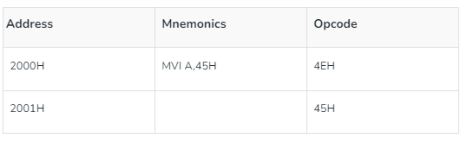
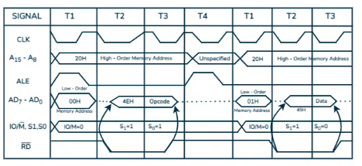
Timing Diagram of MVI A,45H
Loading opcode 4EH from memory 2000H. (Operation Code Loading Machine Cycle)
Read (move) data 45H from memory 2001H. (memory reading).

Slide 25
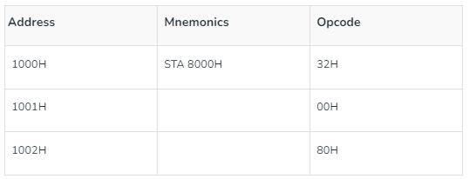
Timing Diagram of STA 8000H
STA stands for Store Accumulator – the contents of the accumulator are stored at (1000H).
The transaction code of STA indicates 32H.
It is provided by 1000H memory (assumed) – In the machine cycle.
Then read the sub address (00). – Memory reading machine cycle
Read higher memory location (80) – Memory read machine cycle.
Consider the combination of the two addresses and write the details of the accumulator for 8000.
Assume the memory address for the instruction and let the content of accumulator is C7H.
So, C7H from accumulator is now stored in 8000H.

Slide 26
